Slide 1
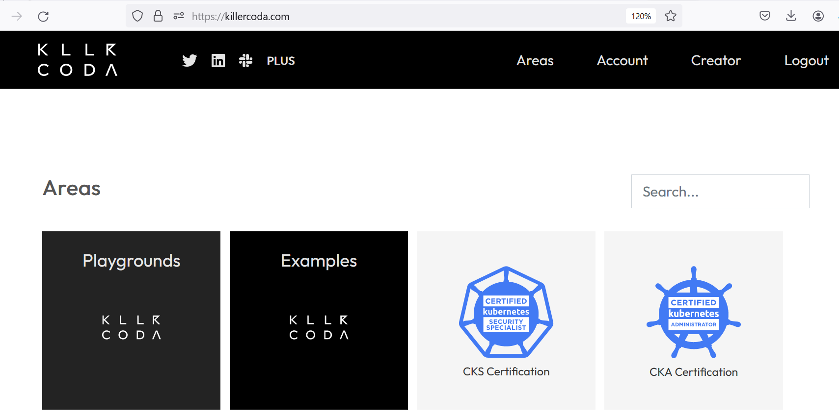
Step1: Lab setup > https://killerkoda.com

Slide 2
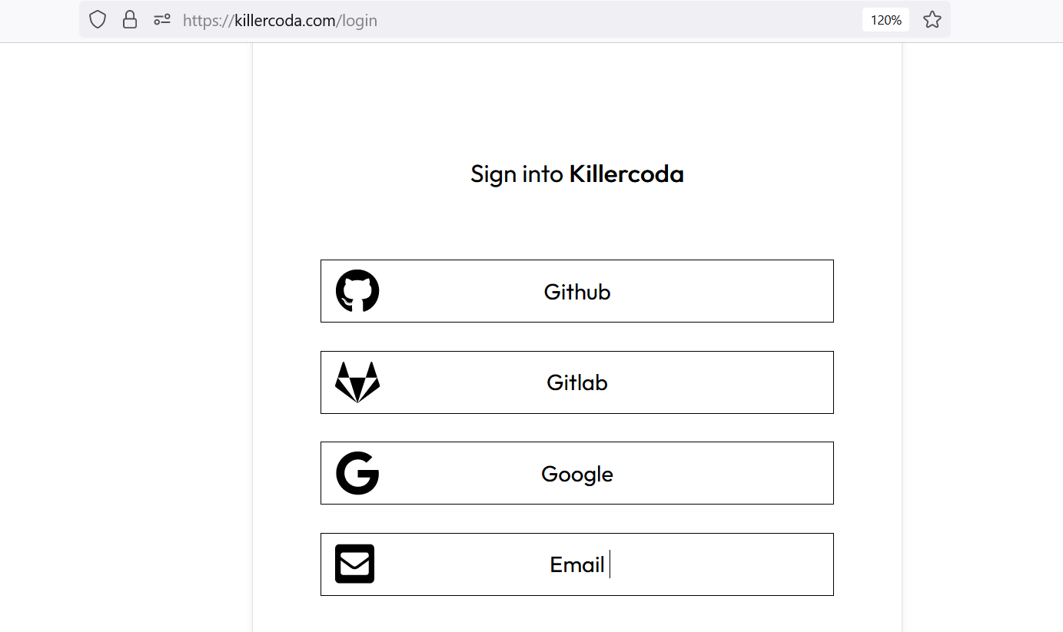
Login option

Slide 3
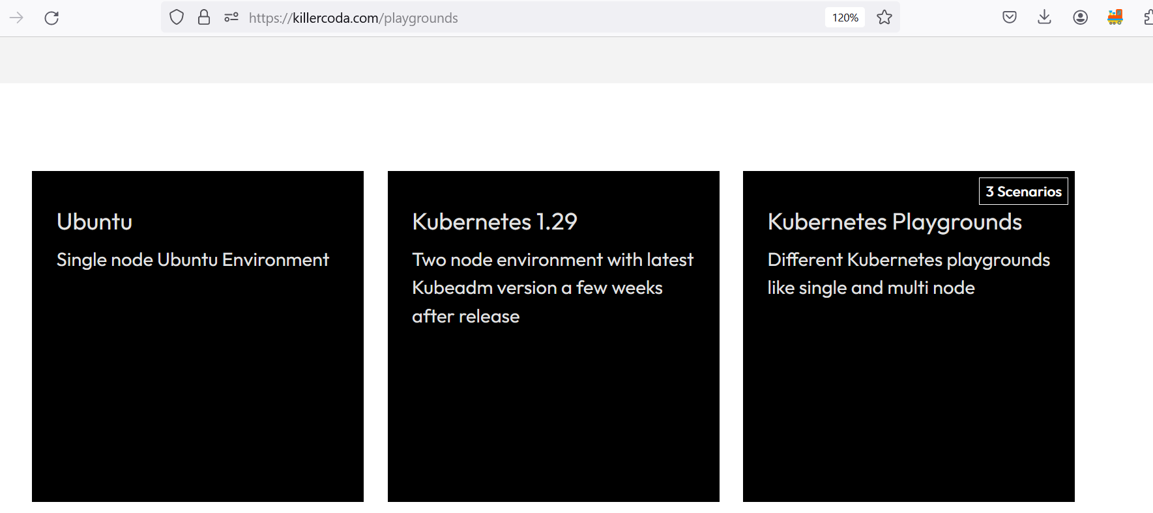
Select ubuntu playground

Slide 4
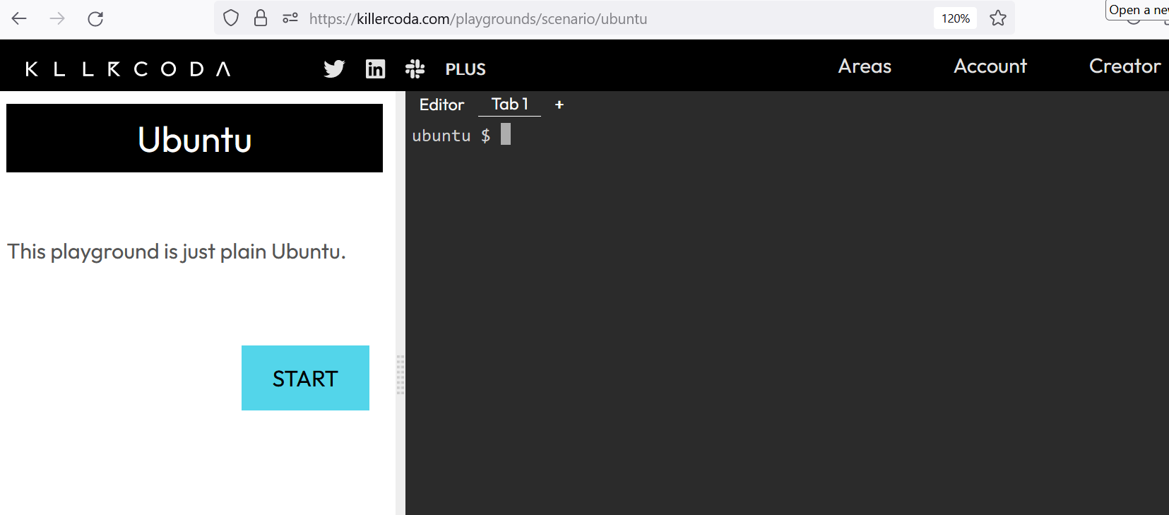
Ubuntu terminal

Slide 5
Step2-Terraform installation on Ubuntu
https://developer.hashicorp.com/terraform/install

Slide 6
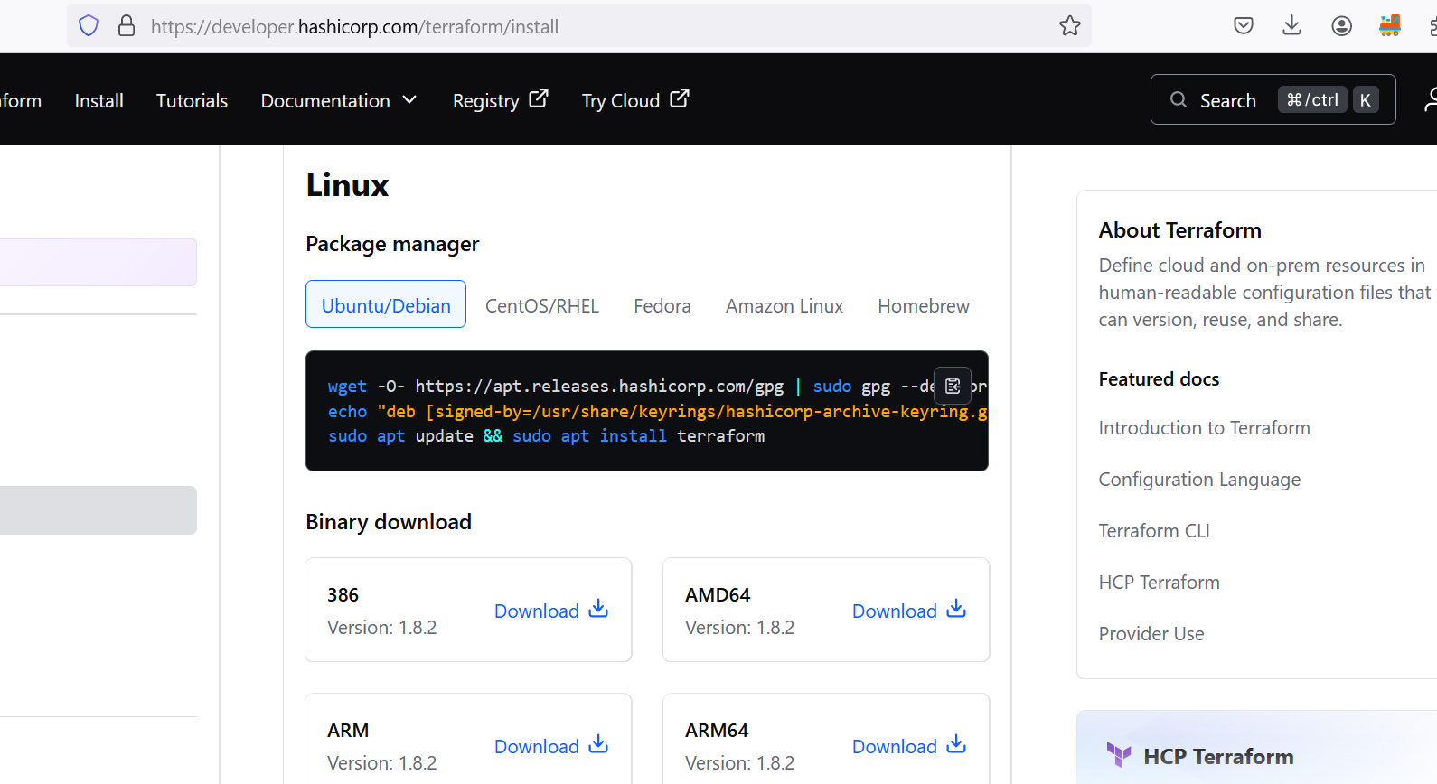

Slide 7
Step3: Authenticate killerkoda with Azure
Step3.1: Azure CLI installation
===================
curl -sL https://aka.ms/InstallAzureCLIDeb | sudo bash
Step3.2: Authentication with Azure for proceeding further
===================================
ubuntu $ az login
To sign in, use a web browser to open the page https://microsoft.com/devicelogin and enter the code XXXXXXXXX to authenticate.

Slide 8
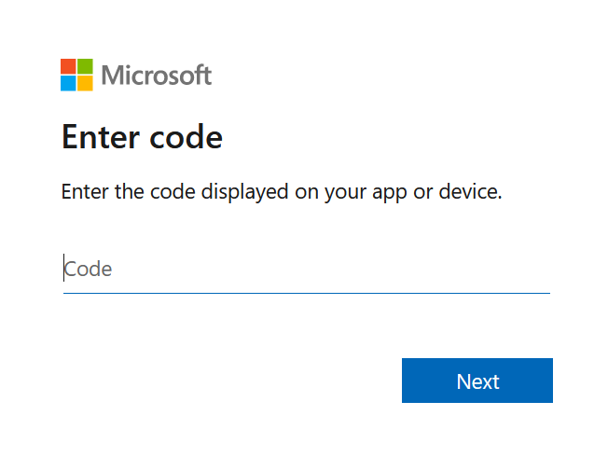
Open the URL into browser and enter the code

Slide 9
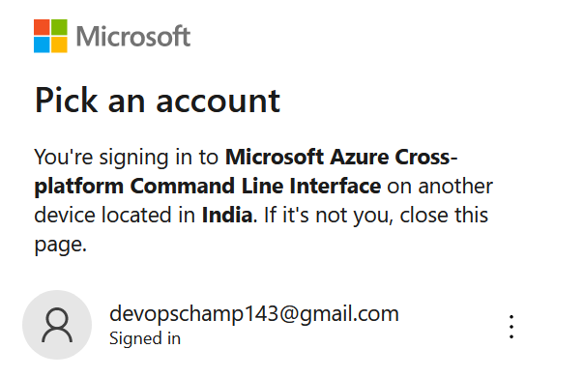
Select the Azure Account with active subscription

Slide 10
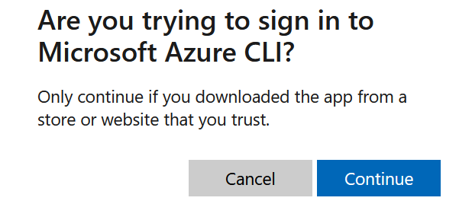
Click on continue

Slide 11
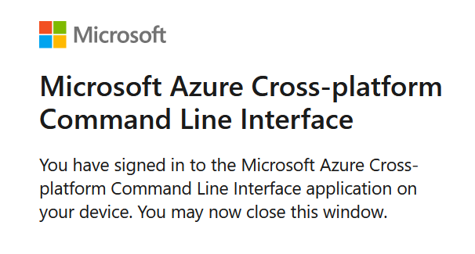
Message after clicking on continue

Slide 12
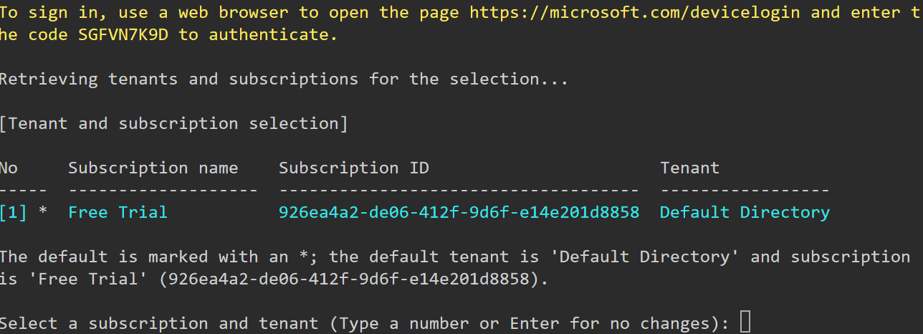
Next SEP
Now, come to linux terminal, you must be seeing like this, click on enter

